Slide 1
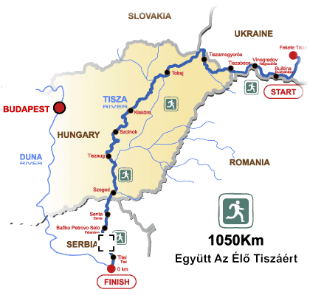
EVROPSKE RUTE EUROPAI UTAK

Slide 2
Miröl van SZó
The Cultural Routes of the Council of Europe are an invitation to travel and to discover the rich and diverse heritage of Europe by bringing people and places together in networks of shared history and heritage. They put into practice the values of the Council of Europe: human rights, cultural diversity, intercultural dialogue and mutual exchanges across borders.

Slide 3
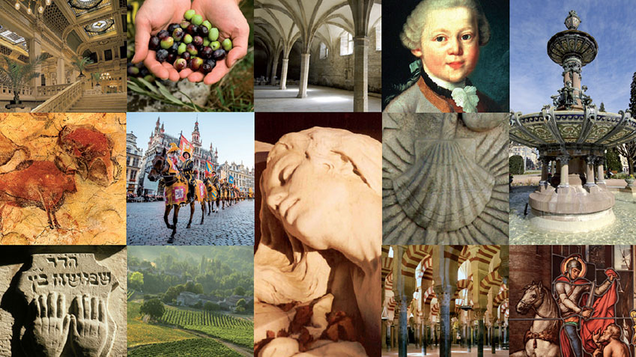
30 útvonal

Slide 4
https://www.coe.int/en/web/cultural-routes/about
In 2017, we count 31 Cultural Routes of the Council of Europe, with very different themes that illustrate European memory, history and heritage and contribute to an interpretation of the diversity of present-day Europe.
The Santiago De Compostela Pilgrim Routes
1987

Slide 5
Subotica
The European Route of Jewish Heritage
2004
ATRIUM - Architecture of Totalitarian Regimes
2014
Réseau Art Nouveau Network
2014
Via Habsburg – POSTOJI POTENCIJAL
2014
2016

Slide 6
Serbia
TRANSROMANICA - The Romanesque Routes of European Heritage
2007
The Iter Vitis Route
2009
The European Cemeteries Route
2010
Réseau Art Nouveau Network
2014
The Roman Emperors and Danube Wine Route

Slide 7
MaGYarország
Member State of the Enlarged Partial Agreement on Cultural Routes since 2013
Certified Cultural Routes of the Council of Europe crossing Hungary:
The Saint Martin of Tours Route
2005
The Iter Vitis Route
2009
European Route of Historic Thermal Towns
2010
Réseau Art Nouveau Network

Slide 8
The Iter Vitis Route
The culture of the vine, winemaking and viticultural landscapes are an important part of European and Mediterranean food culture. Since the domestication of the vine, in the fourth millennium BC, its evolution and spread has been considered a great human achievement, which shaped Europe's landscapes, both in terms of its territory and its people.

Slide 9
Bor Út
Azerbaijan
Bulgaria
Croatia
France
Georgia
Greece
Hungary
Israel
Italy
Malta
Portugal
Republic of Moldova
Russian Federation
Romania
Serbia
Slovenia
Spain
"The former Yugoslav Republic of Macedonia"

Slide 10
Tematikus UTAK

Slide 11
Miroregionalni PUTEVI KISTÉRSEGI UTAK-lehetséges kapcsolodás
Mnoge europske kulturne rute su u nastajanju, tek započete ili na teoretskom nivou osmišljene, u kandidaturi, ali su još bez sertifikata:
Barokne rute – za koje je postojala teoretska podloga (izdan katalog)
Rute jugoistočne Evrope – teoretska podloga
koja podrazumijeva tzv Dijagonalnu cestu u okviru koje je i Via Ragusina
Rute suhozida – kamene pregrade na poljima mediterana
Ruralne rute
Rute industrijske baštine ERIH
Ruta evropskih gradova
Rimske rute (ROMIT)
Đantarna cesta
Via Adriatica

Slide 12
Lépések
1. Saradnja u istraživanju i razvoju
2. Naglasiti memoriju, povijest i europsku baštinu
3. Kulturna i obrazovna razmena za mlade Evropljane
4. Savremena kulturna i umetnička praksa
5. Kulturni turizam i održivi kulturni razvoj

Slide 13
INTEGRÁLIS TURISZTIKAI TERMÉK
ODRŽIVOST I ODGOVORNI TURIZAM NA RUTI
Baština, koja je temeljni sadržaj kulturne rute:
rezultat je emotivne i kreativne energije
vraća tu istu energiju korisnicima
prožeta je emocijama pokoljenja
može zadovoljiti potrebe savremenih turista – izazivati uzbuđenje, ulivati energiju, oduševljavati
interpretacijom usmerava korisnika na emotivnu vrednost, pozitivni aspekt baštine

Slide 14
Mit Kell Elérni
„kulturna baština nikako ne sme postati konzumerski proizvod, niti odnos prema baštini sme biti površan. Tek ukoliko se posetioc može identifikovati sa baštinom, lakše će ceniti njenu vrednost kao i shvatati važnost njenog očuvanja. Kulturni turizam traži od svih odgovornih da posetiocu osiguraju mogućnost da kreativnu spoznaju kombinuje sa uživanjem u svom slobodnom vremenu”.46

Slide 15
Ötletek
Current Candidates
Previous evaluation cycle (2016-17)
Read more about Previous evaluation cycle (2016-17)
European Route of Impressionisms
Longobard Ways Accross Europe
The Chocolate Way - Cultural ethical network of artisan heritage sites

Slide 16
